Slide 1
adventure Works Sales Analytics Project
End-to-End Sales Analysis using SQL, Excel, Power BI & Tableau
Anila.AN

Slide 2
Project Details
Project name : Adventure Works
Dataset: Provided by Adventure Works
Domain: Sales & Business Analytics
Tools Used:
Microsoft Excel (Dashboard & KPI Analysis)
Power BI (Interactive BI Reports)
SQL (Data Extraction & Transformation)
Tableau (Visual Analytics & Storytelling)

Slide 3
Project Overview
The Adventure Works Sales Analytics Project aims to transform raw sales data into meaningful insights.
That help the business understand its performance and make better decisions.
The project follows a complete data analytics lifecycle.
It beginning with data extraction and preparation, and ending with interactive dashboards created using multiple business intelligence tools.
OBJECTIVES
Understand overall sales performance of Adventure Works.
Identify top-performing products and categories.
Analyze year-wise, quarter-wise, and month-wise trends.
Track customer demand and order behavior.
Present insights through interactive dashboards.

Slide 4
Business Problem Statement
Which products contribute the most to revenue?
Which regions generate higher profits?
How does production cost affect overall profitability?
How can the company improve profit margins?

Slide 5
Dataset Overview
Dataset: Adventure Works sample database
Data includes:
Product details
Sales orders
Customer information
Order quantity
Unit price
Unit cost
Discount

Slide 6
Data Preparation
Removed duplicate and null records
Standardized data formats
Verified numerical consistency
Created new calculated fields for analysis

Slide 7
Calculations Used
Sales Amount
= Unit Price × Order Quantity − Discount
Production Cost
= Unit Cost × Order Quantity
Profit
= Sales Amount − Production Cost

Slide 8
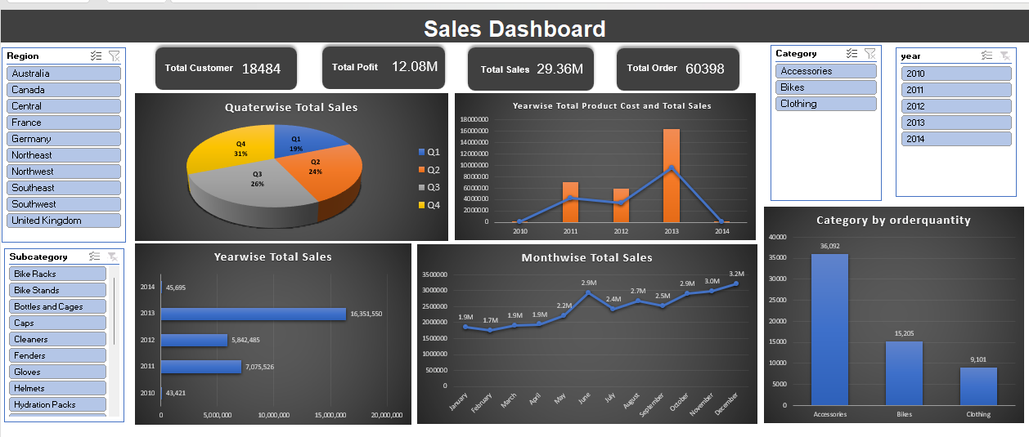
Excel Dashboard Overview
Displays Total Customers, Total Sales, Total Profit, and Total Orders
Visualizes sales distribution by quarter using a pie chart
Shows year-wise and month-wise sales trends
Highlights category-wise order quantity
Includes slicers for Year and Category to enable interactive analysis

Slide 9
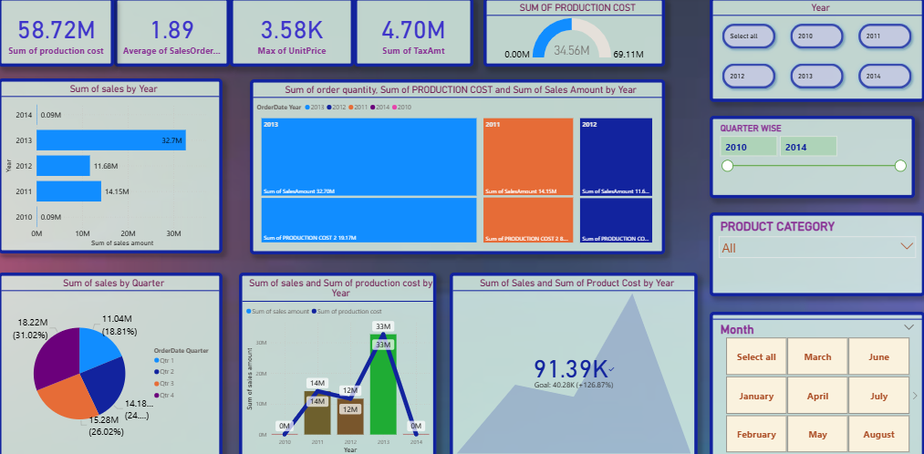
Power bi Dashboard Overview
Shows key KPIs for sales, cost, price, and tax
Analyzes yearly and monthly sales trends
Compares sales vs production cost for profitability
Highlights quarterly and seasonal performance
Includes interactive filters for detailed analysis

Slide 10
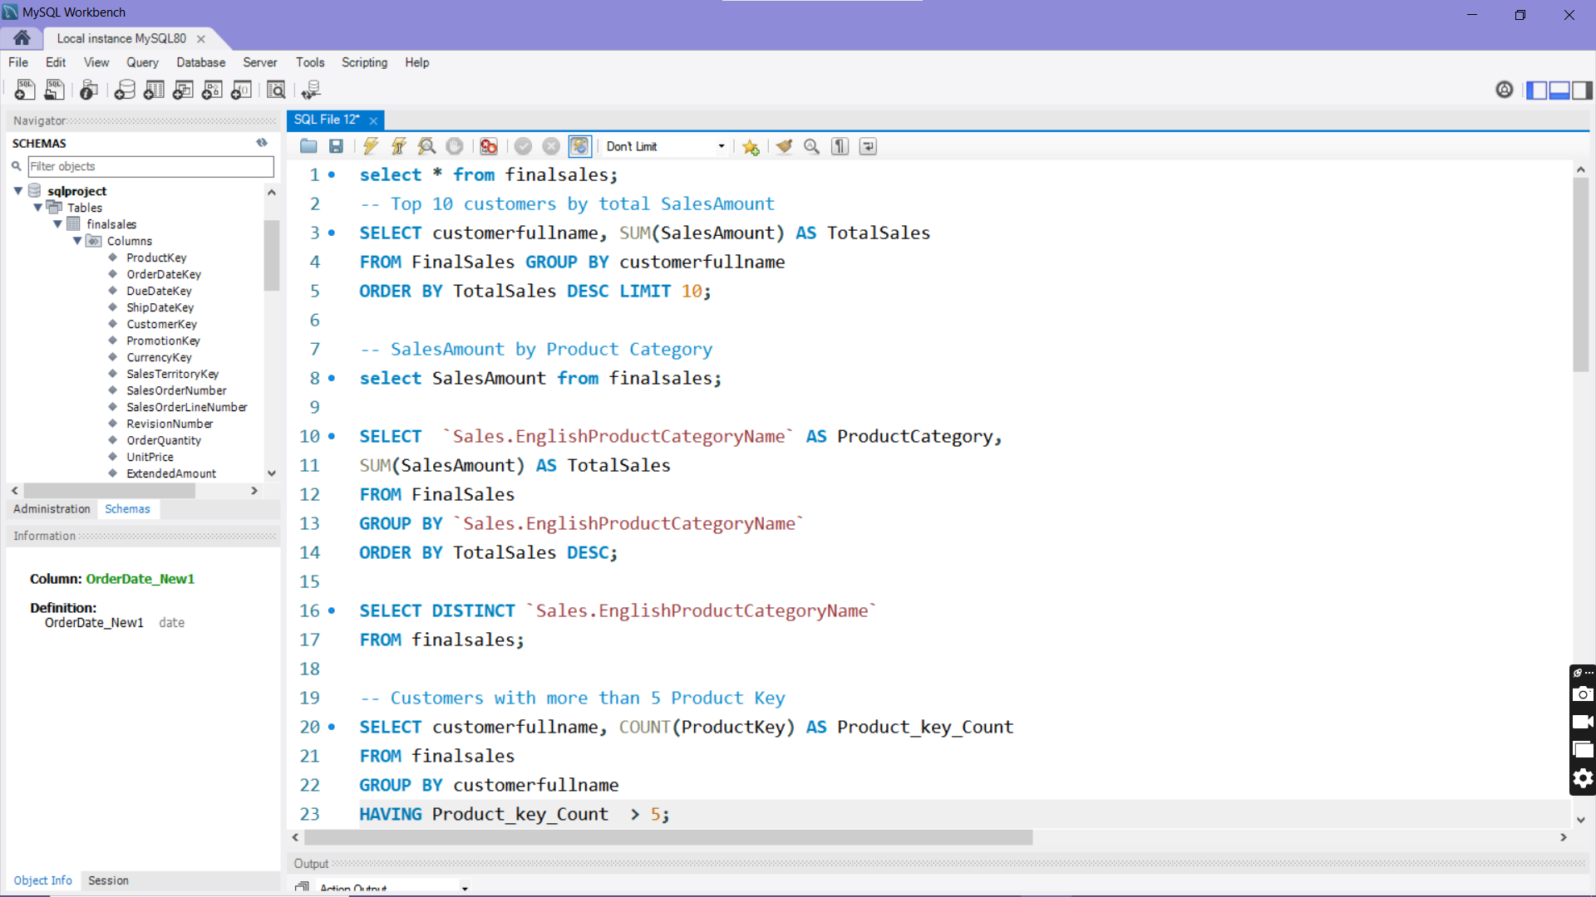
My sql Dashboard Overview
Used MySQL Workbench to analyze Final Sales data.
Final Sales contains customer, product, date, and sales details.
SELECT * used to view and understand the dataset.
Top 10 customers identified using SUM + GROUP BY + ORDER BY + LIMIT.
Sales Amount checked for data validation.
Category-wise sales analyzed using aggregations.
DISTINCT used to fetch unique product categories.
Customer purchase count calculated using COUNT ( Product Key ) .
HAVING > 5 filters high-value customers.

Slide 11
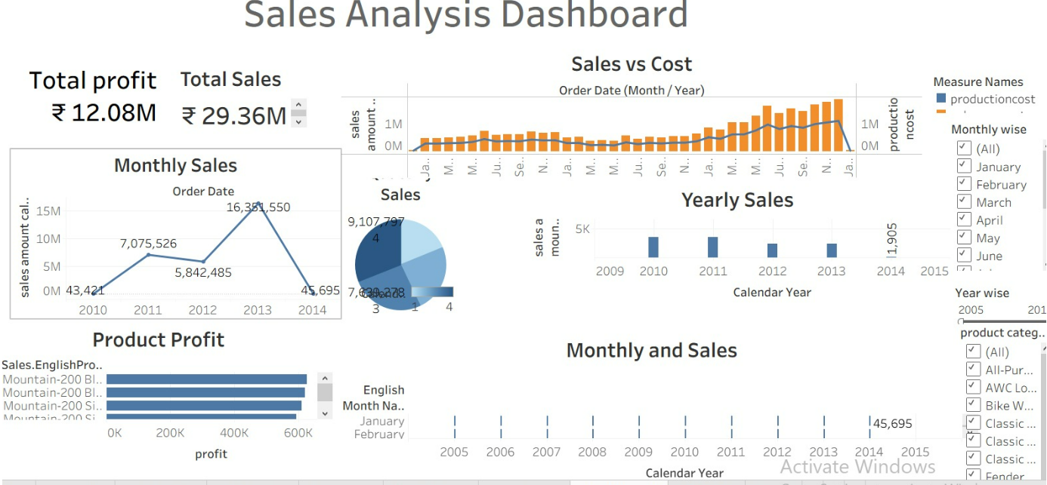
Tableau Dashboard Overview
Displays Total Sales (₹29.36M) and Total Profit (₹12.08M) for overall business performance.
Shows monthly and yearly sales trends to track growth and peak periods.
Compares Sales vs Production Cost to analyze profitability over time.
Highlights product-wise profit, identifying top-performing products.
Provides interactive filters (Month, Year, Product Category) for detailed analysis.

Slide 12
Sales Analysis
Total sales increased during peak seasons
Certain product categories contribute maximum revenue
Monthly and yearly trends show consistent growth
PROFIT ANALYSIS
Some products show high sales but low profit
High production cost directly impacts profit margin
Accessories have better profit percentage compared to some bikes

Slide 13
Region-Wise Performance
Top performing regions generate the highest revenue
Some regions show potential for improvement
Regional demand varies by product category
Key Insights
A small number of products contribute to major profits
Cost optimization can significantly improve margins
Seasonal trends affect sales performance
Data visualization improves decision-making speed

Slide 14
Business Recommendations
Focus marketing on high-profit products
Reduce production cost for low-margin items
Optimize inventory based on sales trends
Expand business in high-performing regions
Challenges Faced
Handling large datasets
Cleaning inconsistent data
Learning advanced formulas / queries
Designing meaningful visualizations

Slide 15
Conclusion
Demonstrates how data analysis provides clear visibility into business performance at Adventure Works.
Helps identify profitable products, trends, and growth opportunities through sales and cost analysis.
Supports data-driven decision-making by transforming raw data into meaningful insights.
Improves strategic planning and operational efficiency using interactive dashboards.
Enables better financial control and long-term business growth.

Slide 16
Future Scope
Sales forecasting
Customer segmentation
Real-time dashboard integration
Advanced predictive analytics

